Slide 1
Lecture 12
CSE 3203
Best First Search

Slide 2
Introduction
Best first search is an instance of graph search algorithm in which a node is selected for expansion based on evaluation function f (n).
Traditionally, the node which is the lowest evaluation is selected for the expansion because the evaluation measures distance to the goal.

Slide 3
Introduction
The evaluation is applied to nodes in the search tree. The function returns a number describing the desirability of expanding a node in order for it to direct search toward the goal. The evaluation function incorporates an estimate of the path cost from the state to a goal.

Slide 4
Introduction
Best first search can be implemented within general search frame work via a priority queue, a data structure that will maintain the fringe(the lastly visited nodes of each path) in ascending order of f values.
This search algorithm serves as combination of depth first and breadth first search algorithm.
Best first search algorithm is often referred greedy algorithm this is because they quickly attack the most desirable path as soon as its heuristic weight becomes the most desirable.

Slide 5
Concept
Step 1: Traverse the root node
Step 2: Traverse any neighbour of the root node, that is maintaining a least distance from the root node and insert them in ascending order into the queue.
Step 3: Traverse any neighbour of neighbour of the root node, that is maintaining a least distance from the root node and insert them in ascending order into the queue
Step 4: This process will continue until we are getting the goal node

Slide 6
Algorithm
Step 1: Place the starting node or root node into the queue.
Step 2: If the queue is empty, then stop and return failure.
Step 3: If the first element of the queue is our goal node, then stop and return success.

Slide 7
Algorithm
Step 4: Else, remove the first element from the queue. Expand it and compute the estimated goal distance for each child. Place the children in the queue in ascending order to the goal distance.
Step 5: Go to step-2
Step 6: Exit.

Slide 8
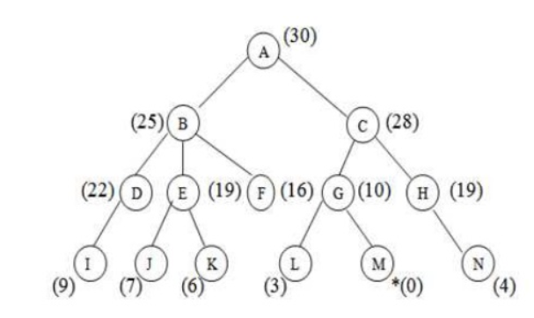
Implementation
Let us solve an example for implementing above BFS algorithm.

Slide 9
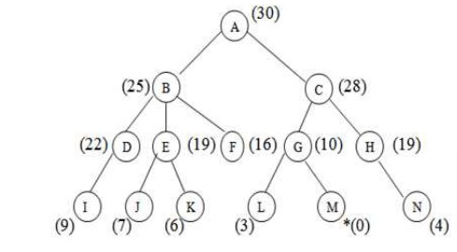
Implementation
Step 1: Consider the node A as our root node. So the first element of the queue is A which is not our goal node, so remove it from the queue and find its neighbour that are to inserted in ascending order.
A(30)

Slide 10
Implementation
Step 2: The neighbours of A are B and C. They will be inserted into the queue in ascending order.
B(25) C(28)
Closed list: A

Slide 11
Implementation
Step 3: Now B is on the FRONT end of the queue.
So calculate the neighbours of B that are maintaining
a least distance from root.
F(16) E(19) D(22) C(28)
Closed list: A,B

Slide 12
Implementation
Step 4: Now F is on the FRONT end of the queue.
However as it has no further children, so remove
it from the queue and proceed further.
E(19) D(22) C(28)
Closed list: A,B,F

Slide 13
Implementation
Step 5: Now E is the FRONT end. So the children of E are J and K.
Insert them into the queue in ascending order.
K(6) J (7) D(22) C(28)
Closed list: A,B,F,E

Slide 14
Implementation
Step 6: Now K is on the FRONT end and as it has no further children, so remove it and proceed further.
J (7) D(22) C(28)
Closed list: A,B,F,E,K

Slide 15
Implementation
Step 7: Also, J has no corresponding children. So remove it and proceed further.
D(22) C(28)
Closed list: A,B,F,E,K,J

Slide 16
Implementation
Step 8: Now D is on the FRONT end. So calculate the children of D and put it into the queue.
I(9) C(28)
Closed list: A,B,F,E,K,J,D

Slide 17
Implementation
Step 9: Also, I has no corresponding children. So remove it and proceed further.
C(28)
Closed list: A,B,F,E,K,J,D,I

Slide 18
Implementation
Step 10: Now C is on the FRONT end. So calculate the children of C and put it into the queue.
G(10) H(19)
Closed list: A,B,F,E,K,J,D,I,C

Slide 19
Implementation
Step 11: Now remove G from the queue and calculate its neighbour to insert in ascending order into the queue.
M(0) L(3) H(19)
Closed list: A,B,F,E,K,J,D,I,C,G

Slide 20
Implementation
Step 12: Now M is the FRONT node of the queue which is our goal node. So stop here and exit.
L(3) H(19)
Closed list: A,B,F,E,K,J,D,I,C,G,M

Slide 21
Comparison
Greedy Best first search is in most cases better than BFS. But it depends on the evaluation function and the structure of the problem. If the evaluation function is not good enough it can mislead the algorithm to expand nodes that look promising, but are far from the goal.
Best first search expands less nodes than Depth-first search.

Slide 22
End

